Slide 1
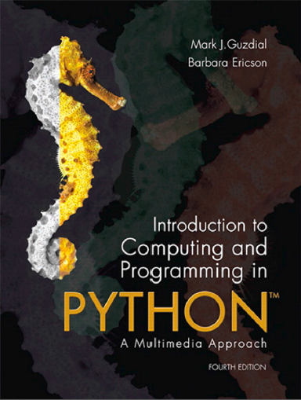
Introduction to Computing and Programming in Python™: A Multimedia Approach
Fourth Edition
Chapter 6
Modifying Pixels by Position
Copyright © 2016, 2013, 2010 Pearson Education, Inc. All Rights Reserved
Notes:
If this PowerPoint presentation contains mathematical equations, you may need to check that your computer has the following installed:
1) MathType Plugin
2) Math Player (free versions available)
3) NVDA Reader (free versions available)

Slide 2
Learning Objectives (1 of 2)
6.1 To mirror pictures horizontally or vertically.
6.2 To compose pictures into one another and create collages.
6.3 To rotate pictures.
6.4 To scale pictures smaller and larger.
6.5 To use blending to combine images.
6.6 To be able to add text and shapes to existing pictures.
6.7 To use blurring to smooth degradation.

Slide 3
Learning Objectives (2 of 2)
6.8 To use nested loops for addressing elements of a matrix.
6.9 To loop through only part of an array.
6.10 To develop some debugging strategies—speciﬁcally, to use print statements to explore executing code.
6.11 To be able to choose between using vector and bitmapped image formats.
6.12 To be able to choose when one should write a program for a task versus using existing applications software.

Slide 4
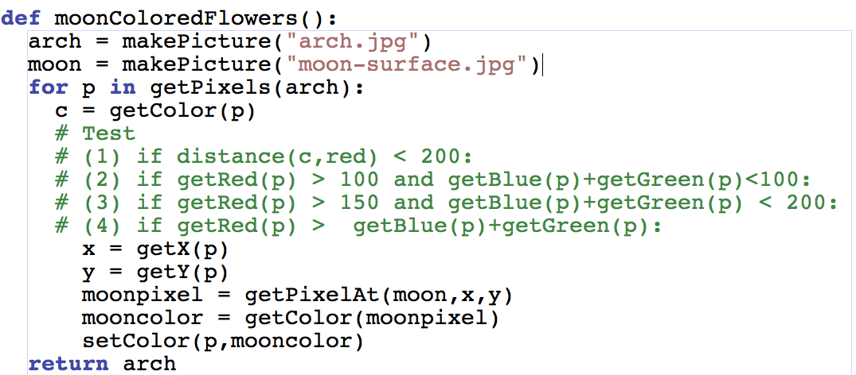

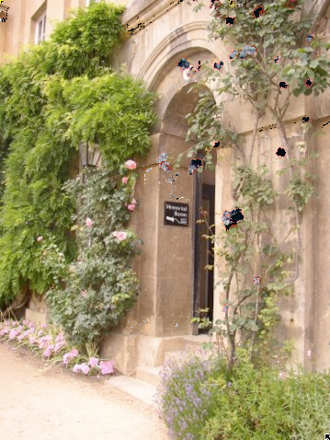
There Are Four Conditional Statements in This Program for Turning the Red Flowers in the Arch into Moon-Colored Flowers
One of the Generated This Image. Which One?
Notes:
#3

Slide 5
Pixels Are in a Matrix
Matrices have two dimensions: A height and a width
We can reference any element in the matrix with (x,y) or (horizontal, vertical)
We refer to those coordinates as index numbers or indices
We sometimes want to know where a pixel is, and getPixels doesn’t let us know that.

Slide 6
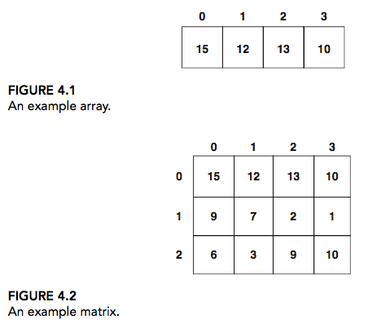
Arrays vs Matrices
Figure 4.1 An example array.
Figure 4.2 An example matrix.

Slide 7
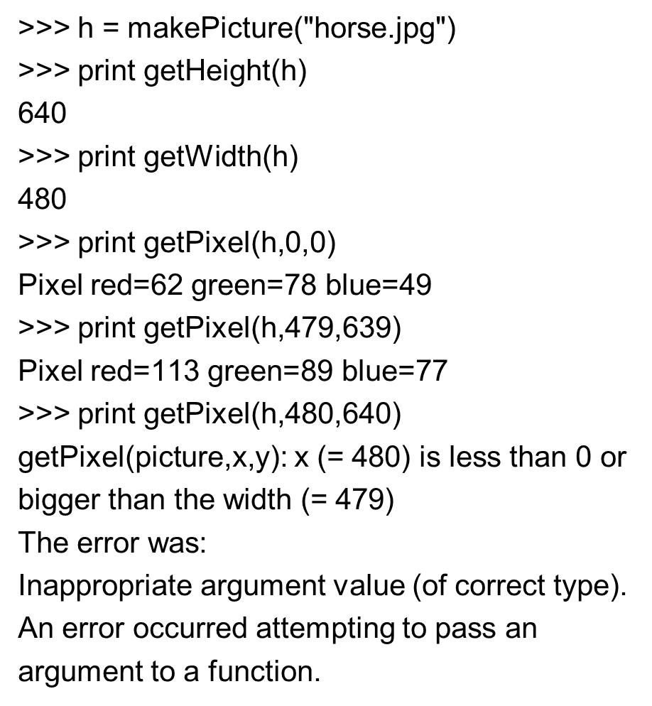
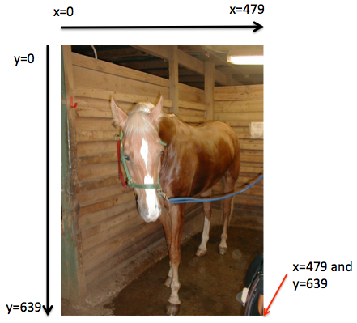
Pixels in a Matrix

Slide 8
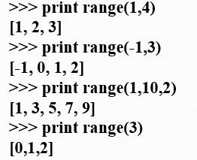
Indices from the Function Range
Range returns a sequence between its first two inputs, possibly using a third input as the increment
Notice:
End value is never included.
range(0,10) ends at 9.
If you leave out a start value, it’s assumed to be zero.

Slide 9
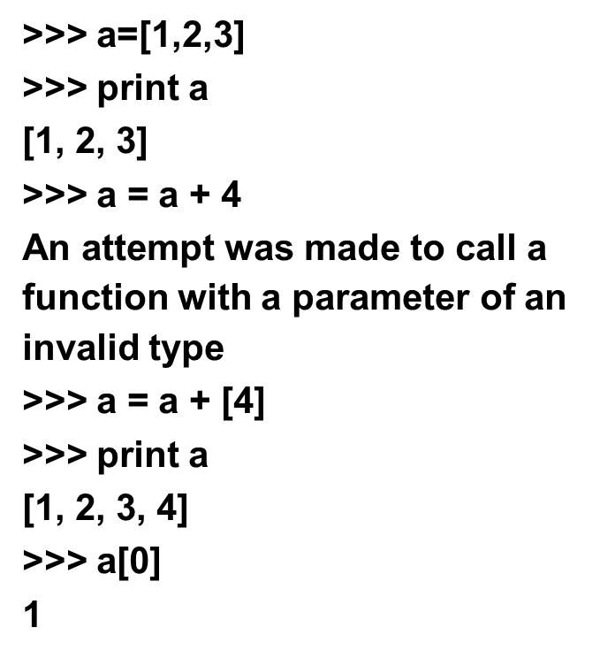
Side Note: That Thing in [] Is a Sequence
We can assign names to sequences, print them, add items to sequences, and access individual pieces of them.
We can also use for loops to process each element of a sequence.

Slide 10
We Can Use Range to Generate Index Numbers
We’ll do this by working the range from 0 to the height-1, and 0 to the width-1.
Using the range function will make it easy to start from 0 and stop before the end value.
But we’ll need more than one loop.
Each for loop can only change one variable, and we need two for indexing a matrix

Slide 11
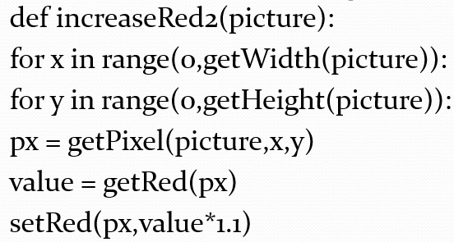
Working the Pixels by Number
To use range, we’ll have to use nested loops
One to walk the width, the other to walk the height
Be sure to watch your blocks (i.e., indentation) carefully!

Slide 12
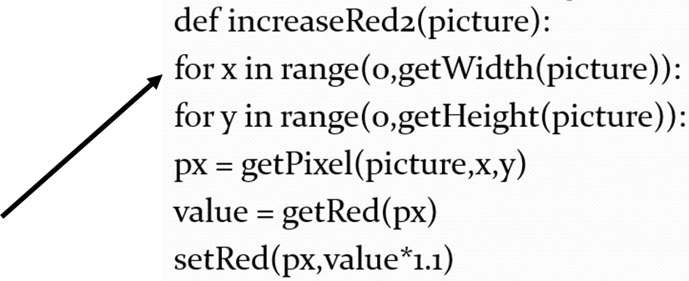
What’s Going on Here?
The first time through the first loop, x is the name for 0.
We’ll be processing the first column of pixels in the picture.

Slide 13
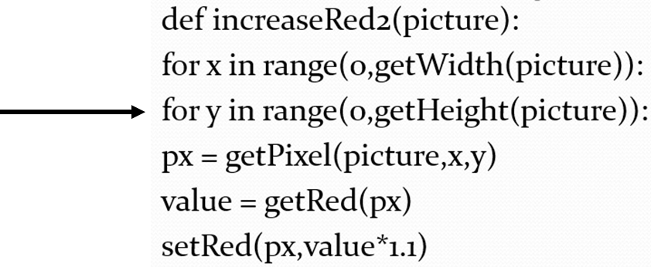
Now, the Inner Loop
Next, we set y to 0. We’re now going to process each of the pixels in the first column.

Slide 14
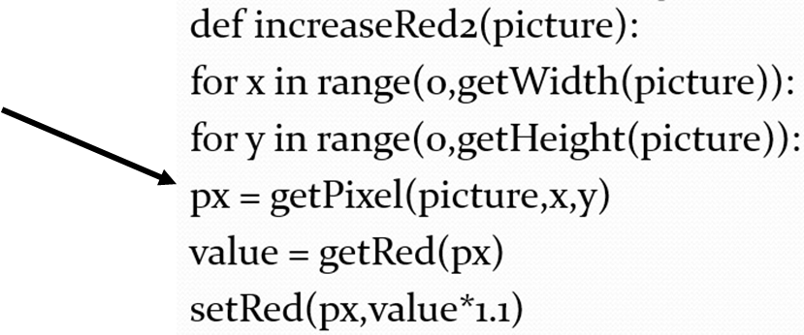
Process a Pixel
With x = 0 and y = 0, we get the leftmost pixel and increase its red by 10%

Slide 15
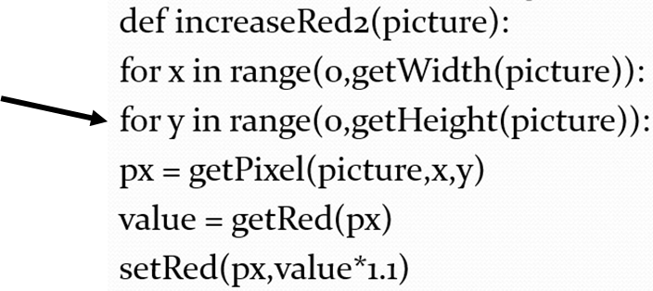
Next Pixel
Next we set y to 1 (next value in the sequence range(0,getHeight(picture))

Slide 16
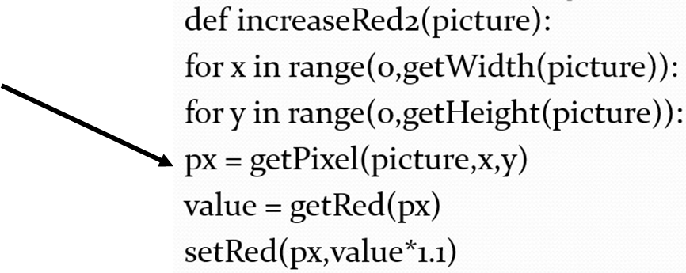
Process Pixel (0,1)
x is still 0, and now y is 1, so increase the red for pixel (0,1)
We continue along this way, with y taking on every value from 0 to the height of the picture (minus 1).

Slide 17
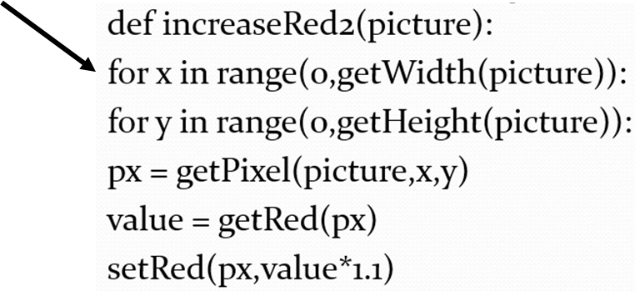
Finally, Next Column
Now that we’re done with the loop for y, we get back to the F o r loop for x. x takes on the value 1, and we go back to the y loop to process all the pixels in the column x=1.

Slide 18
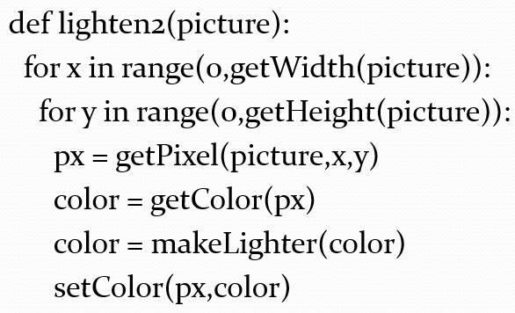
Lightening a Picture with Nested Loops

Slide 19
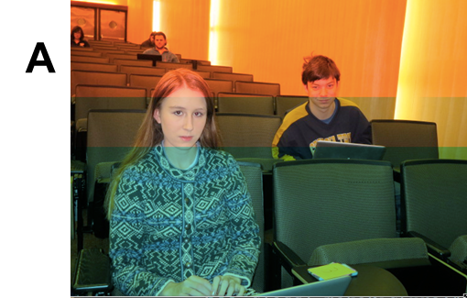
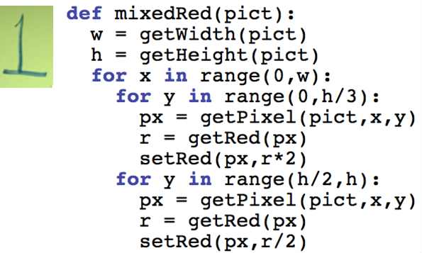
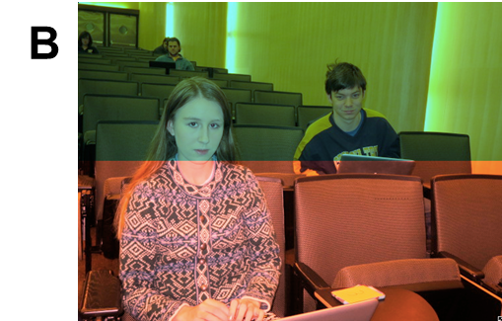
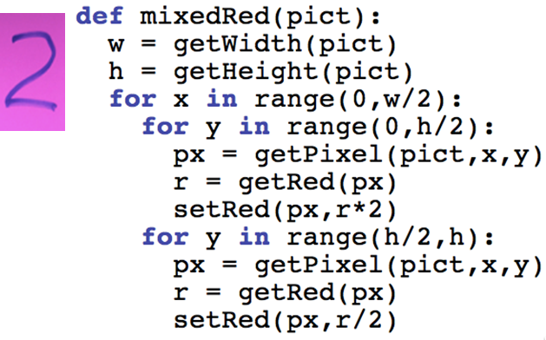
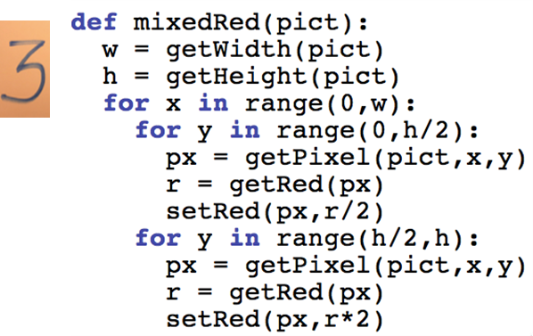

Which Function Did A? (1 of 2)

Slide 20
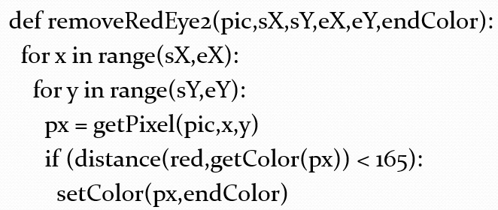
Reducing Red Eye with Nested Loops
This version is far faster than the previous version

Slide 21
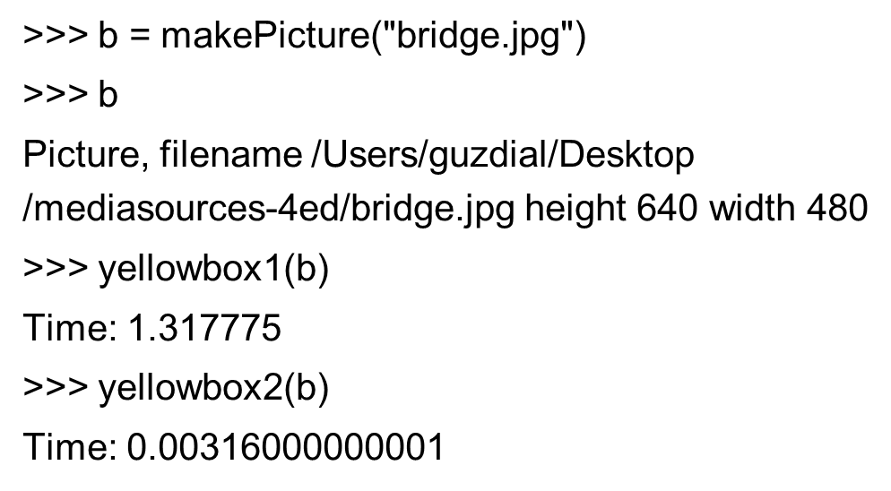
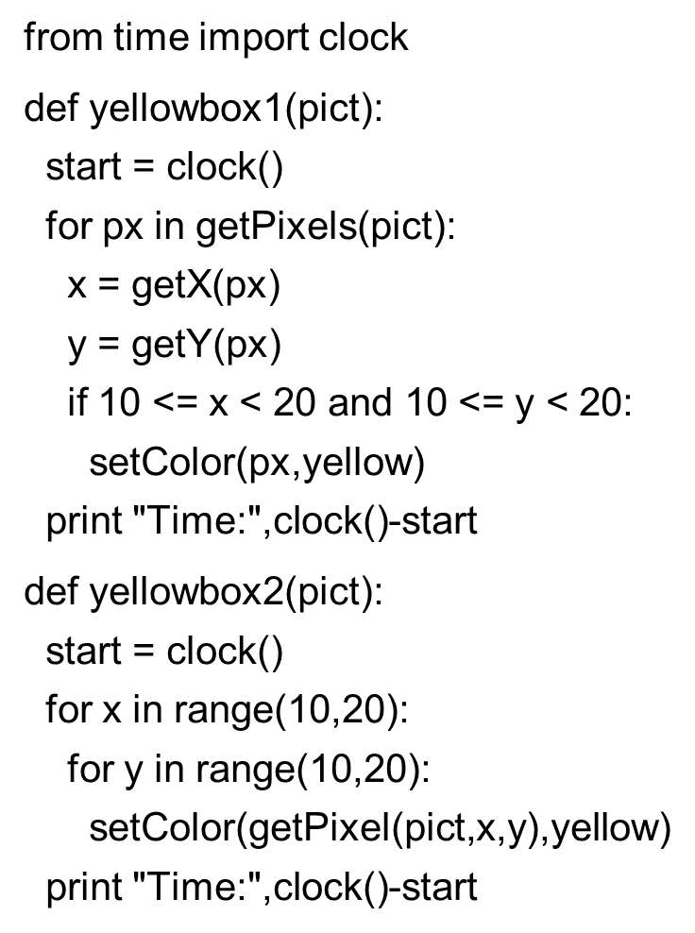
Timing

Slide 22
What Can You Do If You Know Where the Pixels Are? One Answer: Mirroring
Imagine a mirror horizontally across the picture, or vertically
What would we see?
How do generate that digitally?
We simply copy the colors of pixels from one place to another

Slide 23
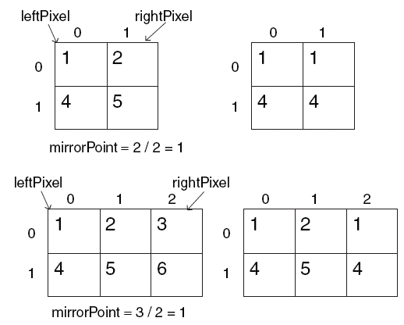
Work It out with Matrices
mirrorPoint is halfway across: getWidth(picture)/2
If left pixel is at (x,y), right pixel is at (width-x-1,y)

Slide 24
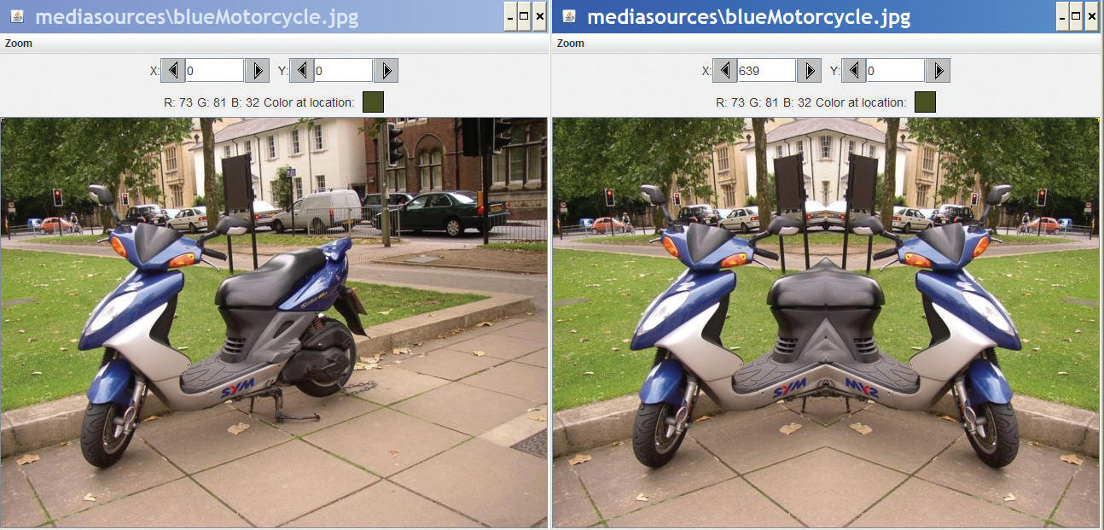
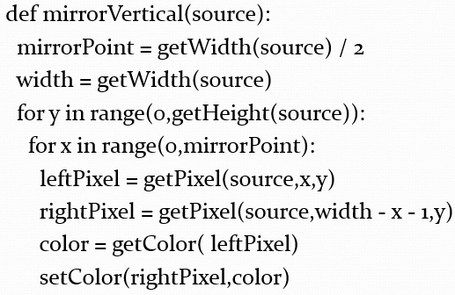
Recipe for Mirroring

Slide 25
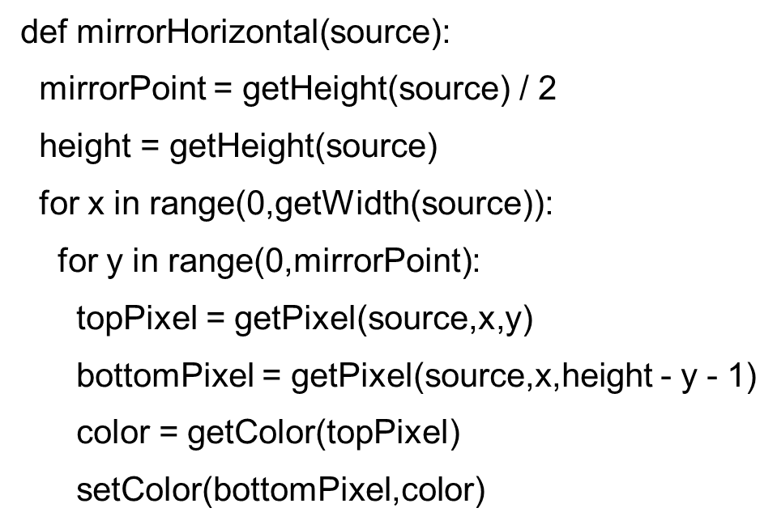
Can We Do It with a Horizontal Mirror?

Slide 26
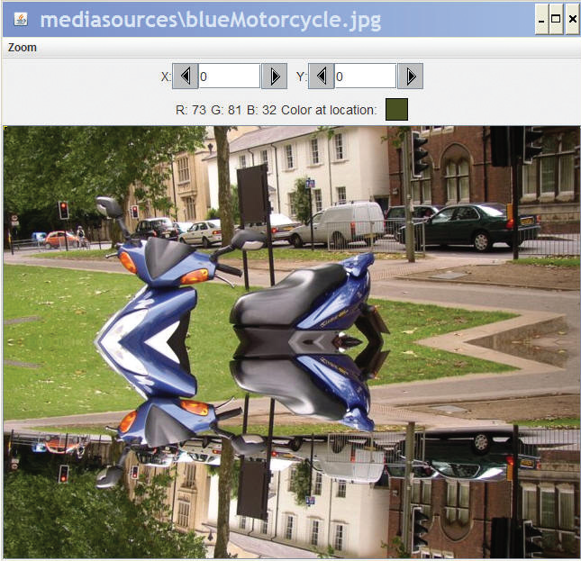
Of Course!

Slide 27
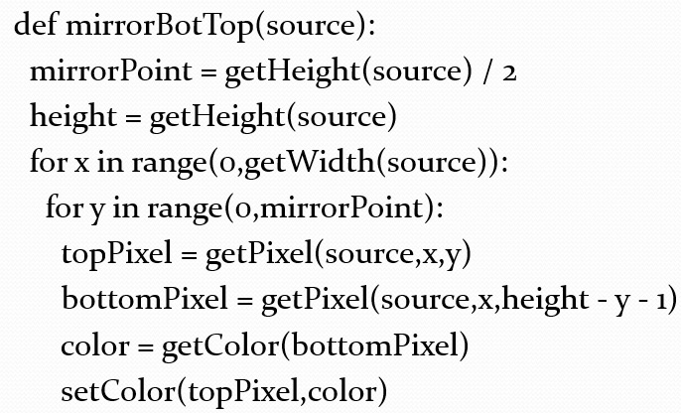
What If We Wanted to Copy Bottom to Top?
Very simple: Swap the order of pixels in the bottom lines

Slide 28
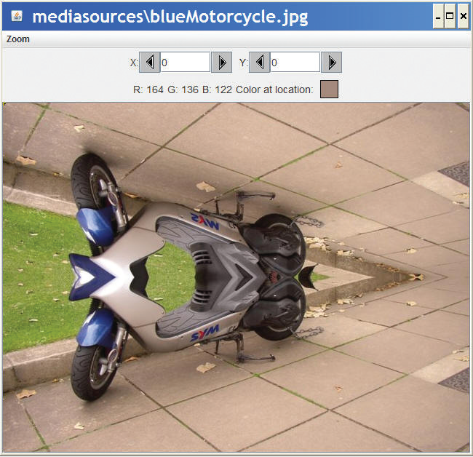
Mirroring Bottom to Top

Slide 29
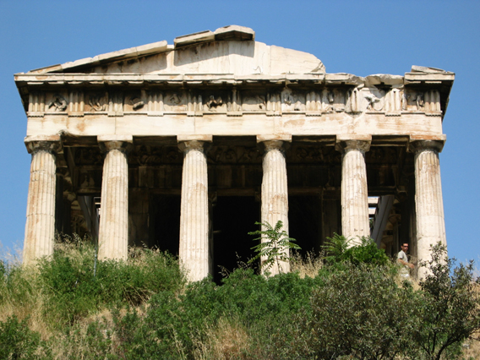
Doing Something Useful with Mirroring
Mirroring can be used to create interesting effects, but it can also be used to create realistic effects.
Consider this image from a trip to Athens, Greece.
Can we “repair” the temple by mirroring the complete part onto the broken part?

Slide 30
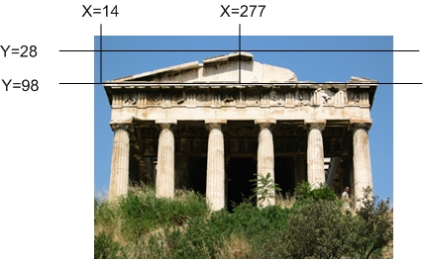
Figuring out Where to Mirror
Use MediaTools to find the mirror point and the range that we want to copy

Slide 31
Writing Functions for Specific Files…Generally
The function to mirror the temple needs to work for one and only one file.
But we still don’t want to write out the whole path.
setMediaPath() allows us to pick a directory where our media will be stored.
getMediaPath(filename) will generate the entire path for us to the filename in the media directory
This only works when we’re accessing files in the media directory and where we have set the path first!

Slide 32
Some Utility Functions
If you know the name of the file, searching for it with pickAFile() feels tedious
You can set and get a media folder (path) for remembering a place where your media will be coming from (or going to)
setMediaPath() lets you pick a file in your media folder
getMediaPath(basefilename) lets you generate a complete filename out of only the last part

Slide 33
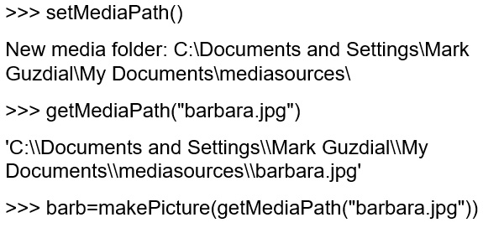
Example

Slide 34
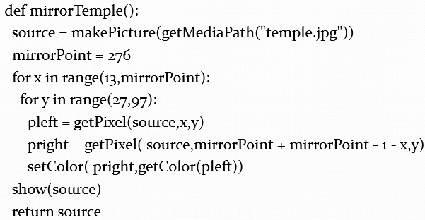
Program to Mirror the Temple

Slide 35
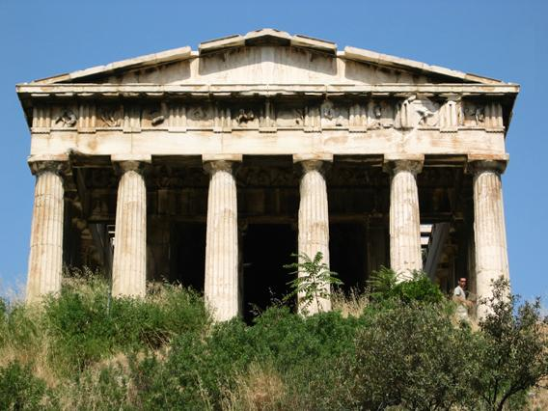
Did It Really Work?
It clearly did the mirroring, but that doesn’t create a 100% realistic image.
Check out the shadows: Which direction is the sun coming from?

Slide 36
Understanding the Temple Fix
What is the very first transfer of pixels from and to? Which (x,y) pixel from? Which (x,y) pixel to?
What is second?
How many pixels get copied?

Slide 37
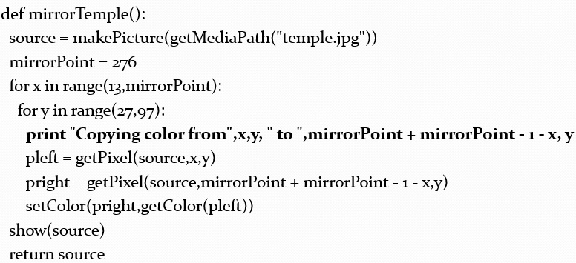
Adding Print Statements to See What’s Happening

Slide 38
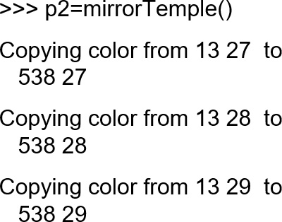
First Pixels Are Either Side of the Mirrorpoint, Then Moving Down

Slide 39
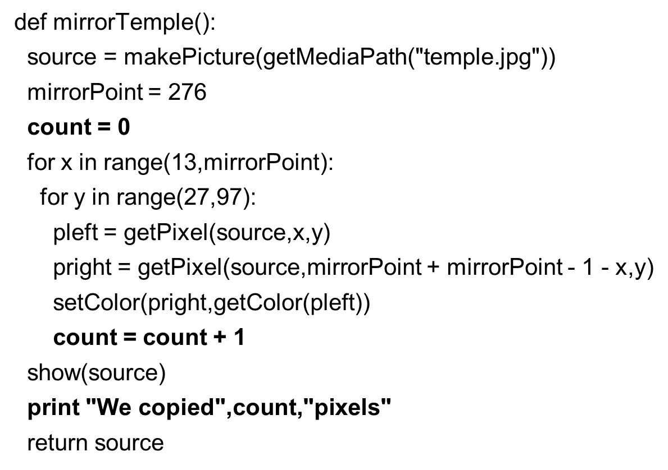
Counting Pixels (1 of 2)

Slide 40
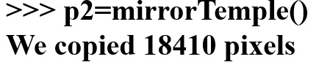
Counting Pixels (2 of 2)
Where did that come from?
How many rows? Y goes from 27 to 97
= 70 rows of pixels
How many columns? X goes from 13 to 276
= 263 columns of pixels
70 × 263 = 18410

Slide 41
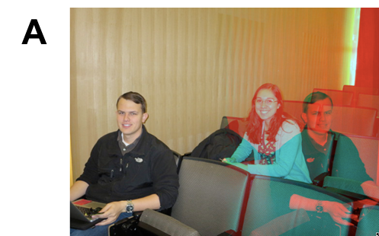
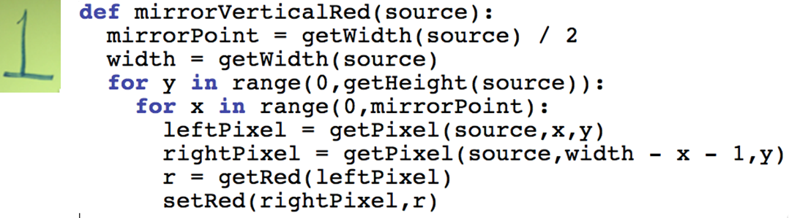

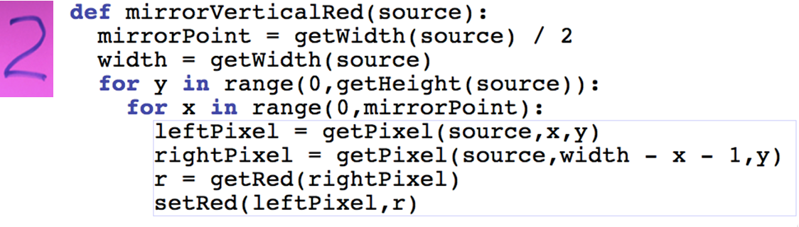
Which Function Did A? (2 of 2)

Slide 42
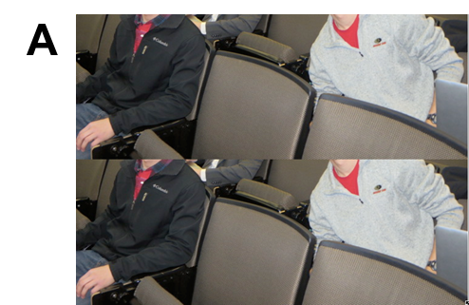
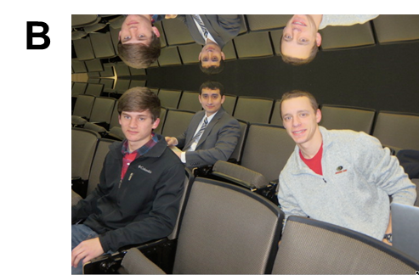

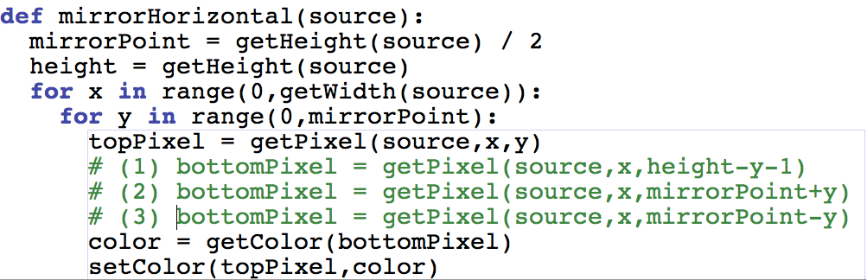
The Same Function Below Did the Two Pictures, but with One Line Difference. Which One Did Which Picture?

Slide 43
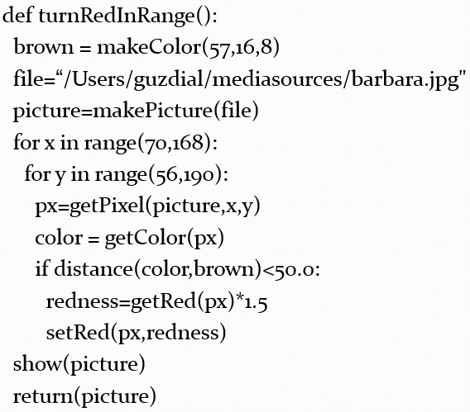

Replacing Colors in a Range
Get the range using MediaTools

Slide 44
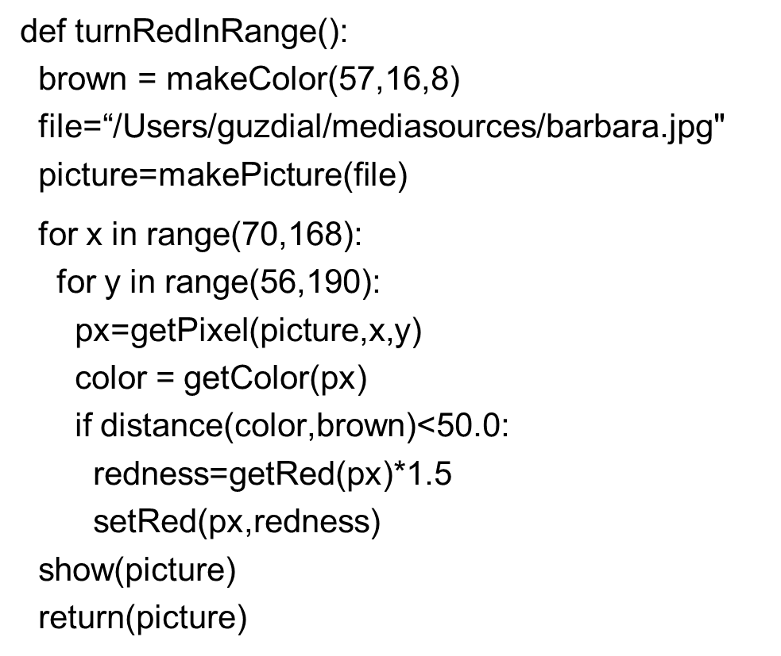
Walking This Code
Like last time: Don’t need input, same color we want to change, same file, make a picture

Slide 45
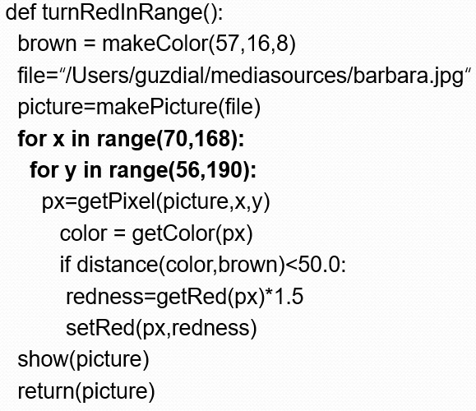
The Nested Loop
I used MediaTools to find the rectangle where most of the hair is that I want to change

Slide 46
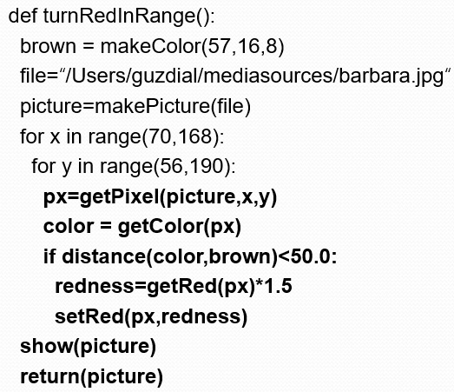
Same Thing as Last Time (Could Raise Threshold Now)
Then we’re looking for a close-match on hair color, and increasing the redness

Slide 47

Could We Do This Without Nested Loops?
Yes, but complicated I F

Slide 48
Moving Pixels Across Pictures
We’ve seen using index variables to track the pixel position we’re working with in a picture.
We can copy between pictures, if we keep track of:
The source index variables
Where we’re getting the pixels from
The target index variables
Where we’re putting the pixels at
(Not really copying the pixels: Replicating their color.)

Slide 49
What Can You Do Then?
What can you do when copying from one picture to another?
Collages: Copy several pictures onto one
Cropping: You don’t have to take the whole picture
Scaling: Make a picture smaller, or larger when copying it

Slide 50
Copying Pixels
In general, what we want to do is to keep track of a sourceX and sourceY, and a targetX and targetY.
We increment (add to them) in pairs
sourceX and targetX get incremented together
sourceY and targetY get incremented together
The tricky parts are:
Setting values inside the body of loops
Incrementing at the bottom of loops

Slide 51


Copying Barb to a Canvas

Slide 52
Comments
Python ignores from “#” through the rest of the line
If you start a line with “#”, the whole line is ignored
Why do we want lines to be ignored?
To be able to leave notes to ourselves or someone else about how the program works

Slide 53

Walking Through the Copying Function
First, get the source (barb) and target (canvas) files and pictures as names we can use later.

Slide 54

The Actual Copy
We get the color of the pixel at sourceX and sourceY
We set (copy) the color to the pixel in the target picture at targetX and targetY

Slide 55

Setting up the Copy Loop
targetX gets set to 0 at the beginning
sourceX will range across the width of the source picture
Inside the loop, we set targetY to 0
Inside because we want it to start at 0 each time we do a new X
sourceY will range from 0 to one less height of source

Slide 56

Ending the Loop
Just before we end the sourceY loop, we increment targetY
It’s now set up for the next time through the loop
It’s set correctly for the next value of sourceY
Just before we end the sourceX loop, we increment the targetX
Note carefully the indentation to figure out which goes with which loop

Slide 57
What’s This Naming Something as Itself?
targetX = targetX + 1
This isn’t really naming something as itself
targetX + 1 is evaluated
It will result in the number after targetX
targetX = then sets the value of targetX
The result is that targetX gets incremented by 1

Slide 58

Ending the Copy Function
At the very end, we show the source and target
And return the modified target.

Slide 59

Works Either Way
As long as we increment sourceX and targetX together, and sourceY and targetY together, it doesn’t matter which is in the for loop and which is incremented via expression

Slide 60


Copying into the Middle of the Canvas

Slide 61


Copying a Horse to a Canvas

Slide 62

Copying Another Way

Slide 63


Copying to a New Location

Slide 64


Cropping Just the Face

Slide 65

Same Cropping, Different Loops

Slide 66

Copying: How It Works
Here’s the initial setup:

Slide 67

Copying: How It Works 2
After incrementing the sourceY and targetY once (whether in the for or via expression):

Slide 68

Copying: How It Works 3
After yet another increment of sourceY and targetY:
When we finish that column, we increment sourceX and targetX, and start on the next column.

Slide 69

Copying: How It Looks at the End
Eventually, we copy every pixel

Slide 70

Making a Collage (1 of 2)
Could we do something to the pictures we copy in?
Sure! Could either apply one of those functions before copying, or do something to the pixels during the copy.
Could we copy more than one picture!
Of course! Make a collage!

Slide 71

Creating a Collage (1 of 2)

Slide 72

Can We Make That Easier? (1 of 2)
The collage code is long, yet simple.
It’s the same thing over-and-over.
We can generalize that copying loop, and with parameters, use it in many places.

Slide 73


Exact Same Collage! (1 of 2)

Slide 74

Make Sure You Have This Typed I N to Work From: Copy Any Pic

Slide 75



Bigger or Smaller? (1 of 2)
Does this function make the src bigger or smaller on the canvas?
Increases size by 50%
Decreases size by 50%
Decreases size by 50% and skips some pixels in target
Increases size by 50% and skips some pixels in target

Slide 76


Bigger or Smaller? (2 of 2)

Slide 77
Transformation = Small Changes in Copying
Making relatively small changes in this basic copying program can make a variety of transformations.
Change the targetX and targetY, and you copy wherever you want
Cropping: Change the sourceX and sourceY range, and you copy only part of the program.
Rotating: Swap targetX and targetY, and you end up copying sideways
Scaling: Change the increment on sourceX and sourceY, and you either grow or shrink the image.

Slide 78


Copying Face to Small Canvas

Slide 79


Changing While Copying

Slide 80

Copying vs. Referencing

Slide 81

Referencing Works Differently

Slide 82
Making a Collage (2 of 2)
Could we do something to the pictures we copy in?
Sure! Could either apply one of those functions before copying, or do something to the pixels during the copy.
Could we copy more than one picture!
Of course! Make a collage!

Slide 83

Creating a Collage (2 of 2)

Slide 84

Can We Make That Easier? (2 of 2)
The collage code is long, yet simple.
It’s the same thing over-and-over.
We can generalize that copying loop, and with parameters, use it in many places.

Slide 85

Exact Same Collage! (2 of 2)

Slide 86


Rotating the Copy

Slide 87


Rotating: How It Works
We increment the same, but we use targetX for the Y coordinate and targetY for the X coordinate

Slide 88


Rotate: How It Ends
Same amount of increment, even same values in the variables, but a different result.

Slide 89

Doing a Real Rotation

Slide 90
Scaling
Scaling a picture (smaller or larger) has to do with sampling the source picture differently
When we just copy, we sample every pixel
If we want a smaller copy, we skip some pixels
We sample fewer pixels
If we want a larger copy, we duplicate some pixels
We over-sample some pixels

Slide 91

Scaling the Horse Face Down

Slide 92


Scaling the Picture Down

Slide 93

Scaling Up: Growing the Picture
To grow a picture, we simply duplicate some pixels
We do this by incrementing by 0.5, but only use the integer part.

Slide 94

Scaling Up

Slide 95

Scaling up Just the Face

Slide 96


Scaling the Picture up

Slide 97

Scaling up: How It Works
Same basic setup as copying and rotating:

Slide 98

Scaling up: How It Works 2
But as we increment by only 0.5, and we use the int() function, we end up taking every pixel twice.
Here, the blank pixel at (0,0) in the source gets copied twice onto the canvas.

Slide 99
Scaling up: How It Works 3
Black pixels gets copied once…

Slide 100

Scaling up: How It Works 4
And twice…

Slide 101

Scaling up: How It Ends up
We end up in the same place in the source, but twice as much in the target.
Notice the degradation:
Gaps that weren’t there previously
Curves would get “choppy”: Pixelated

Slide 102
What to Do?
How do we clear up the degradation of scaling up?
Variety of techniques, but mostly following the same basic idea:
Use the pixels around to figure out what color a new pixel should be, then somehow (e.g., by averaging) compute the right color.
Different techniques look at different pixels and compute different averages in different ways.

Slide 103

A Simple Blur

Slide 104

A Different Blur
We’ll see pass and else later, but you can probably get a sense here of what’s going on.

Slide 105


Blurring out the Pixelation

Slide 106
Average from Four Sides, to Compute New Color

Slide 107
Things to Try:
Can you come up with general copy, rotate, copy, and scale functions?
Take input pictures and parameters
Return the canvas the correct transformation applied
Also think about generalizing the transformations:
Scaling up and down by non-integer amounts
Rotating by something other than 90 degree increments

Slide 108
Blending Pictures
How do we get part of one picture and part of another to blur together, so that we see some of each?
It’s about making one a bit “transparent.”
Video cards sometimes support this transparency in hardware, called an alpha level to each pixel.
We do it as a weighted sum
If it’s 50-50, we take 50% of red of picture1’s pixels + 50% of red of picture2's pixels, and so on for green and blue, across all overlapping pixels.

Slide 109

Example Blended Picture

Slide 110

Blending Code (1 of 3)
Straightforward copy of 150 column’s of Barb’s picture

Slide 111

Blending Code (2 of 3)
Here’s the trick. For each pixel, grab 50% of each red, green and blue

Slide 112

Blending Code (3 of 3)

Slide 113


Drawing Lines on Carolina
We can use the color name “black” – it's pre-defined for us.

Slide 114
Yes, some Colors Are Already Defined
Colors defined for you already: black, white, blue, red, green, gray, lightGray, darkGray, yellow, orange, pink, magenta, and cyan

Slide 115
That’s Tedious
That’s slow and tedious to set every pixel you want to make lines and text, etc.
What you really want to do is to think in terms of your desired effect (think about “requirements” and “design”)

Slide 116
New Functions
addText(pict,x,y,string) puts the string starting at position (x,y) in the picture
addLine(picture,x1,y1,x2,y2) draws a line from position (x1,y1) to (x2,y2)
addRect(pict,x1,y1,w,h) draws a black rectangle (unfilled) with the upper left hand corner of (x1,y1) and a width of w and height of h
addRectFilled(pict,x1,y1,w,h,color) draws a rectangle filled with the color of your choice with the upper left hand corner of (x1,y1) and a width of w and height of h

Slide 117


The Mysterious Red Box on the Beach

Slide 118


Example Picture

Slide 119
A Thought Experiment
Look at that previous page: Which has a fewer number of bytes?
The program that drew the picture
The pixels in the picture itself.
It’s a no-brainer
The program is less than 100 characters (100 bytes)
The picture is stored on disk at about 15,000 bytes

Slide 120
Vector-Based vs. Bitmap Graphical Representations
Vector-based graphical representations are basically executable programs that generate the picture on demand.
Postscript, Flash, and AutoCAD use vector-based representations
Bitmap graphical representations (like J P E G, BMP, GIF) store individual pixels or representations of those pixels.
J P E G and GIF are actually compressed representations

Slide 121
Vector-Based Representations Can Be Smaller
Vector-based representations can be much smaller than bit-mapped representations
Smaller means faster transmission (Flash and Postscript)
If you want all the detail of a complex picture, no, it’s not.

Slide 122
But Vector-Based Has More Value Than That
Imagine that you’re editing a picture with lines on it.
If you edit a bitmap image and extend a line, it’s just more bits.
There’s no way to really realize that you’ve extended or shrunk the line.
If you edit a vector-based image, it’s possible to just change the specification
Change the numbers saying where the line is
Then it really is the same line
That’s important when the picture drives the creation of the product, like in automatic cutting machines

Slide 123
How Are Images Compressed?
Sometimes lossless using techniques like run length encoding (R L E)
Instead of this: B B Y Y Y Y Y Y Y Y Y B B
We could say “9 Y’s” like this: B B 9 Y B B
Lossy compression (like J P E G and G I F) loses detail, some of which is invisible to the eye.

Slide 124
When Changing the Picture Means Changing a Program…
In a vector-based drawing package, changing the drawing is changing a program.
How could we reach in and change the actual program?
We can using string manipulation
The program is just a string of characters
We want to manipulate those characters, in order to manipulate the program

Slide 125

Example Programmed Graphic
If I did this right, we perceive the left half as lighter than the right half
In reality, the end quarters are actually the same colors.

Slide 126

Building a Programmed Graphic

Slide 127


Another Programmed Graphic

Slide 128


And Another

Slide 129
Why Do We Write Programs?
Could we do this in Photoshop? Maybe
I’m sure that you can, but you need to know how.
Could I teach you to do this in Photoshop? Maybe
Might take a lot of demonstration
But this program is an exact definition of the process of generating this picture
It works for anyone who can run the program, without knowing Photoshop

Slide 130
We Write Programs to Encapsulate and Communicate Process
If you can do it by hand, do it.
If you need to teach someone else to do it, consider a program.
If you need to explain to lots of people how to do it, definitely use a program.
If you want lots of people to do it without having to teach them something first, definitely use a program.

Slide 131

Copyright

